Slide 1

DATA 406 – Capstone Project Crash Reporting
Team Members that completed this assignment:
Priti
Mujeeb Adedolapo Yusuf
Yuvraj Singh

Slide 2

Business Understanding High Level

Slide 3
Case Study
Crash Reporting - Drivers Data:
https://catalog.data.gov/dataset/crash-reporting-drivers-data

Slide 4
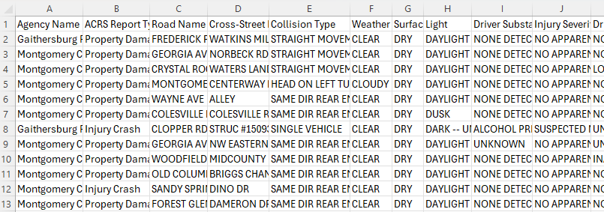
Dataset
This dataset provides information on motor vehicle (drivers) involved in traffic collisions occurring on county and local roadways within Montgomery County. The data is collected via the Automated Crash Reporting System (ACRS) of the Maryland State Police and reported by the Montgomery County Police.
Columns:
Date
Road Name
Collision Type
Weather
Time
Light
Vehicle Year
Vehicle Model
Surface Condition
Vehicle Body Type
Vehicle Movement
Driver Distracted By
Rows-97954 Columns-22

Slide 5
Introduction
We, as data analyst consultants, have been engaged by the Montgomery County Department of Transportation (MCDOT) with the mission to enhance road safety through data-driven insights. Our primary focus is to delve into the crash reporting drivers' dataset, discern patterns, and formulate actionable recommendations for policy enhancements and targeted safety initiatives. Our project objective is to identify trends, contributing factors, and areas for improvement on local roads, thereby facilitating evidence-based strategies to optimize traffic management and advance collision prevention efforts.

Slide 6
5W 1H Analysis 1 – Who
# | Question | Answer
Q1.1 | Who is involved? | The stakeholders involved include Montgomery County transportation department, data analysts, and relevant law enforcement agencies.
Q1.2 | Who is affected? | Road users, residents, and local businesses in Montgomery County are affected by the outcomes of the analysis, as improved road safety measures impact the community's well-being and daily activities.
Q1.3 | Who will benefit? | Beneficiaries include residents of Montgomery County, motorists, pedestrians, and cyclists, as well as the transportation department and law enforcement agencies striving for improved road safety.
Q1.4 | Who will be harmed? | Potential harm could affect individuals involved in traffic collisions, including drivers, passengers, pedestrians, and cyclists, as well as their families and communities.
Notes:
The questions on this slide are sourced from this article:
https://premium.wpmudev.org/blog/a-simple-sure-fire-way-to-create-great-content-the-5-w-the-h/
Who is involved?
Who is affected?
Who will benefit?
Who will be harmed?

Slide 7
5W 1H Analysis 2 – What
# | Question | Answer
Q2.1 | What is your topic narrowed down in a simple phrase/sentence? | Analyzing Montgomery County's traffic collision data to enhance road safety through Power BI graph visualizations and evidence-based insights for informed decision-making.
Q2.2 | What does your topic involve? (i.e. What are the different parts to it?) | The topic involves analyzing traffic collision data, exploring variables like collision types, weather conditions, driver behaviors, and vehicle characteristics to enhance road safety strategies.
Q2.3 | What is it similar to / different from? | It is similar to other traffic collision datasets for analysis but differs based on its specificity to Montgomery County, offering unique insights for localized road safety improvements.
Q2.4 | What might be affected/changed by your topic? | The analysis may lead to changes in road safety policies, targeted interventions at high-risk locations, improved traffic management, and increased public awareness for safer driving practices.
Notes:
The questions on this slide are sourced from this article:
https://premium.wpmudev.org/blog/a-simple-sure-fire-way-to-create-great-content-the-5-w-the-h/
What is your topic narrowed down in a simple phrase/sentence?
What does your topic involve? (i.e. What are the different parts to it?)
What is it similar to / different from?
What might be affected/changed by your topic?

Slide 8
5W 1H Analysis 3 –When
# | Question | Answer
Q3.1 | When does this take place? When did this take place? When will it take place? When should this take place? | The analysis occurs presently, using historical data. It took place in the past to derive insights. Future analyses will continue, informing ongoing road safety efforts. Ideally, it should happen regularly to maintain up-to-date insights for effective interventions and continuous improvement in road safety.
Q3.2 | Does when this takes place affect the topic? | Yes, the timing of the analysis impacts the relevance and accuracy of insights. Current data ensures relevance, while historical data provides context for trends and patterns.
Notes:
The questions on this slide are sourced from this article:
https://premium.wpmudev.org/blog/a-simple-sure-fire-way-to-create-great-content-the-5-w-the-h/
When does this take place? When did this take place? When will it take place? When should this take place?
Does when this takes place affect the topic?

Slide 9
5W 1H Analysis 4 – Where
# | Question | Answer
Q4.1 | Where does this take place? (Where did it …. Where will it … Where should it ….?) | This analysis focuses on traffic collision data within Montgomery County, examining specific locations, roadways, and intersections to derive insights for targeted road safety improvements.
Q4.2 | Does it matter where it takes place? Is it affected by location? | Yes, the analysis is affected by location as it focuses on specific geographic areas within Montgomery County for road safety improvements.
Notes:
The questions on this slide are sourced from this article:
https://premium.wpmudev.org/blog/a-simple-sure-fire-way-to-create-great-content-the-5-w-the-h/
Where does this take place? (Where did it …. Where will it … Where should it ….?)
Does it matter where it takes place? Is it affected by location?

Slide 10
5W 1H Analysis 5 – Why
# | Question | Answer
Q5.1 | Why is this topic important? Why does it matter? | This topic is vital as it addresses road safety, impacting public health, transportation efficiency, and community well-being, striving to reduce accidents and enhance overall safety.
Q5.2 | Why do certain things happen? (What are some causes and effects within the topic?) | Collisions occur due to various factors like weather, distracted driving, and substance abuse, influencing injury severity and vehicle damage. Analyzing these relationships informs targeted preventive measures.
Notes:
The questions on this slide are sourced from this article:
https://premium.wpmudev.org/blog/a-simple-sure-fire-way-to-create-great-content-the-5-w-the-h/
Why is this topic important? Why does it matter?
Why do certain things happen? (What are some causes and effects within the topic?)

Slide 11
5W 1H Analysis 6 – How
# | Question | Answer
Q6.1 | How does this topic work? How does it function? How does it do what it does? | This topic works by analyzing traffic collision data, identifying patterns and correlations among various factors, and deriving insights to inform road safety strategies and interventions.
Q6.2 | How did it come to be? | The analysis originated from the need to address traffic safety concerns in Montgomery County, prompting the collection and analysis of relevant collision data.
Q6.3 | How are those involved affected? | Stakeholders such as motorists, pedestrians, and residents are impacted through informed road safety measures, potentially leading to reduced collisions and improved overall safety.
Notes:
The questions on this slide are sourced from this article:
https://premium.wpmudev.org/blog/a-simple-sure-fire-way-to-create-great-content-the-5-w-the-h/
How does this topic work? How does it function? How does it do what it does?
How did it come to be?
How are those involved affected?

Slide 12
Data Understanding High Level

Slide 13
Data Modeling – Conceptual Model
Driver
Driver at fault
Substance Abuse
Distracted by
Injury Severity
Collision
Report number
ACRS Report Type
Collision Type
Weather
Latitude
Longitude
Date and Time
M
M
Vehicle
Body Type
Movement
Speed Limit
Year
Make Company
Model
Equipment Problems
M
M
M
M
Agency Name
Maryland State Police
Montgomery County Police
Gaithersburg Police
Rockville Police
Maryland-National Capital Park Police
Road
Road name
Cross-Street name
Surface condition
1
1

Slide 14
Data Dictionary
No | Topic | Definition
1 | ACRS Report Type | The type of report filed indicating the severity and nature of the collision.
2 | Collision Type | Categorization of the collision based on the manner in which it occurred (e.g., rear-end, sideswipe, head-on).
3 | Driver at Fault | Indicator of whether the driver was at fault in the collision.
4 | Substance Abuse | Indicates whether substance abuse was a factor in the collision.
5 | Distracted By | Factor(s) contributing to the driver's distraction at the time of the collision.
6 | Injury Severity | The severity of injuries sustained by the driver, classified into categories such as fatal injury, No apparent Injury, possible injury, suspected minor injury and suspected serious injury.
7 | Body Type | The type of vehicle involved in the collision (e.g., sedan, SUV, truck).

Slide 15
Business Understanding Low Level

Slide 16
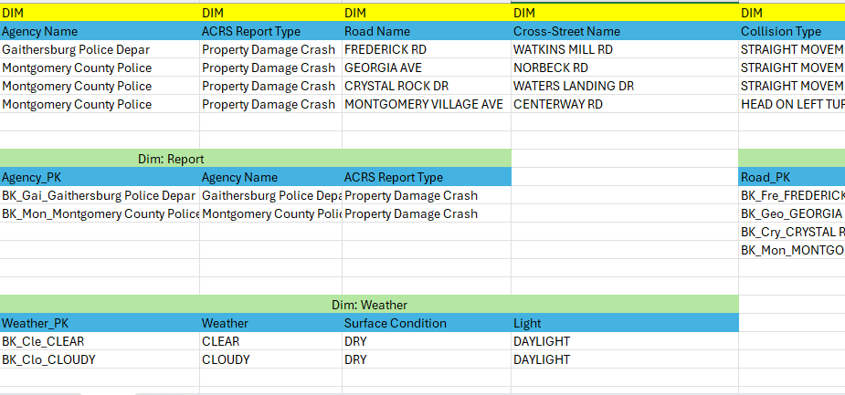
Data Modeling

Slide 17
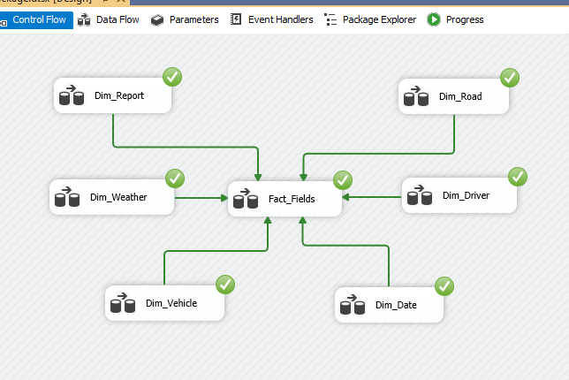
DATA MODELING

Slide 18
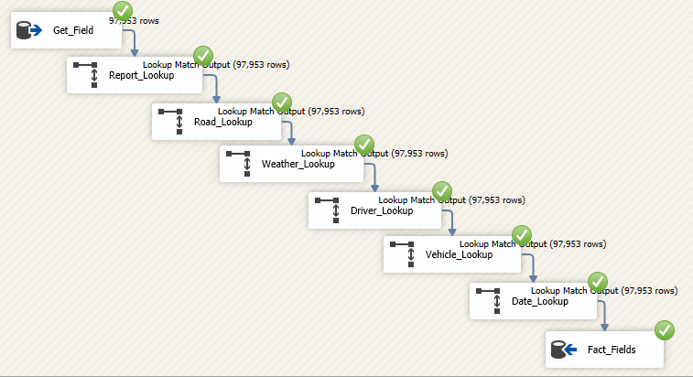
DATA MODELING

Slide 19
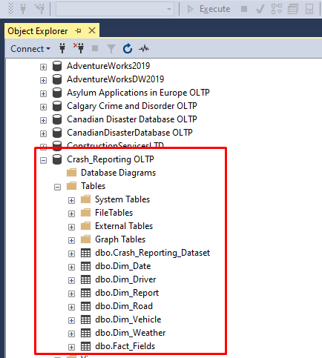
SQL Result After DATA MODELING​
​

Slide 20
Data Understanding Low Level

Slide 21
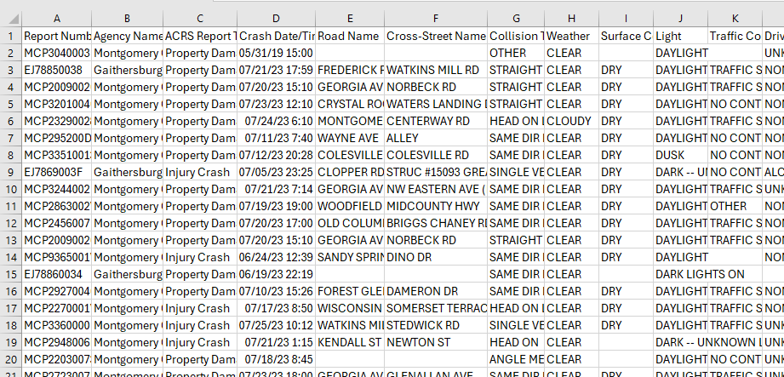
Database Diagram – Tables and Columns
Notes:
Load the Data Set into SQL Server.
Use the SQL Server Management Studio (SSMS) Diagramming tool to produce the Database Diagram.

Slide 22
Data Preparation

Slide 23
Data Preparation – Data cleansing
First, data cleaning was performed in the excel to ensure the quality and accuracy of the data. The null and empty values, duplicates, outliers, and errors were removed from the data.
Afterward, we imported the dataset into VS Code and utilized Python programming to split the combined Date and Time column into separate columns and adjust their data types accordingly.
Following the import process, we transitioned the data to SQL Server Management Studio (SSMS) for executing data queries and extracting the necessary information.
Subsequently, we proceeded to design the data modeling using SQL Server Integration Services (SSIS).
Following this step, we generated visualizations in Python and PowerBI using the data retrieved from SQL queries.
Notes:
Document any data cleansing that was required, any quality issues encountered with the data.

Slide 24
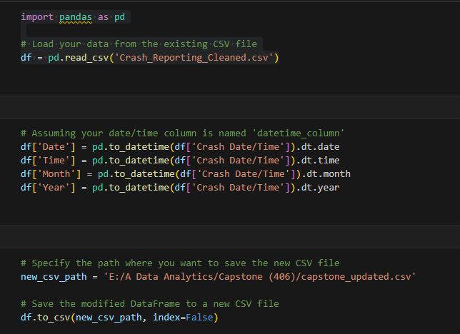
Data Preparation – Python coding

Slide 25
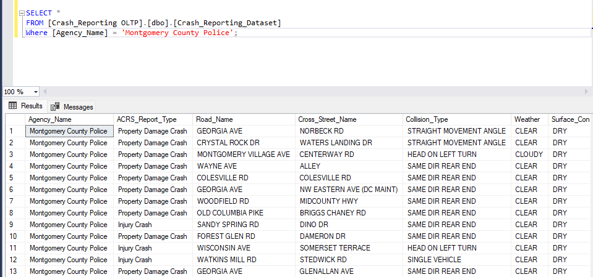
Data Preparation – SQL Query
Notes:
Use the SQL Server Management Studio (SSMS) tool to produce the SQL Query.
In this slide provide the SQL Query in text format, not screen shot format.

Slide 26
Modeling

Slide 27
Business Questions
How do collision counts vary by year and month, and what does this indicate about potential seasonal risk factors or effectiveness of safety measures?
How can Montgomery County optimize road safety strategies and speed limit policies across different roadways to mitigate the risk of traffic collisions and minimize injury severity, especially under varying weather conditions?
How can we strategically allocate resources for emergency response and traffic safety enhancements in areas with high frequencies of severe injuries resulting from traffic collisions?
How can be develop and optimize data-driven road safety policies that specifically mitigate the risks associated with driver substance abuse and distraction?
How can the analysis of collision frequencies associated with specific vehicle body types, makes, movements, and equipment issues inform the development of target vehicle safety standards and accident prevention protocols?

Slide 28

Visualization (Dashboard)
Notes:
Provide a screen shot of the visualization built in Power BI or Tableau.

Slide 29

Visualization (Trend Analysis)
Notes:
Provide a screen shot of the visualization built in Power BI or Tableau.

Slide 30

Visualization (Risk Evaluation)
Notes:
Provide a screen shot of the visualization built in Power BI or Tableau.

Slide 31
Visualization (Geographical Analysis)
Notes:
Provide a screen shot of the visualization built in Power BI or Tableau.

Slide 32
Visualization (Driver Factor Analysis)
Notes:
Provide a screen shot of the visualization built in Power BI or Tableau.

Slide 33
Visualization (Vehicle Factor Analysis)
Notes:
Provide a screen shot of the visualization built in Power BI or Tableau.

Slide 34
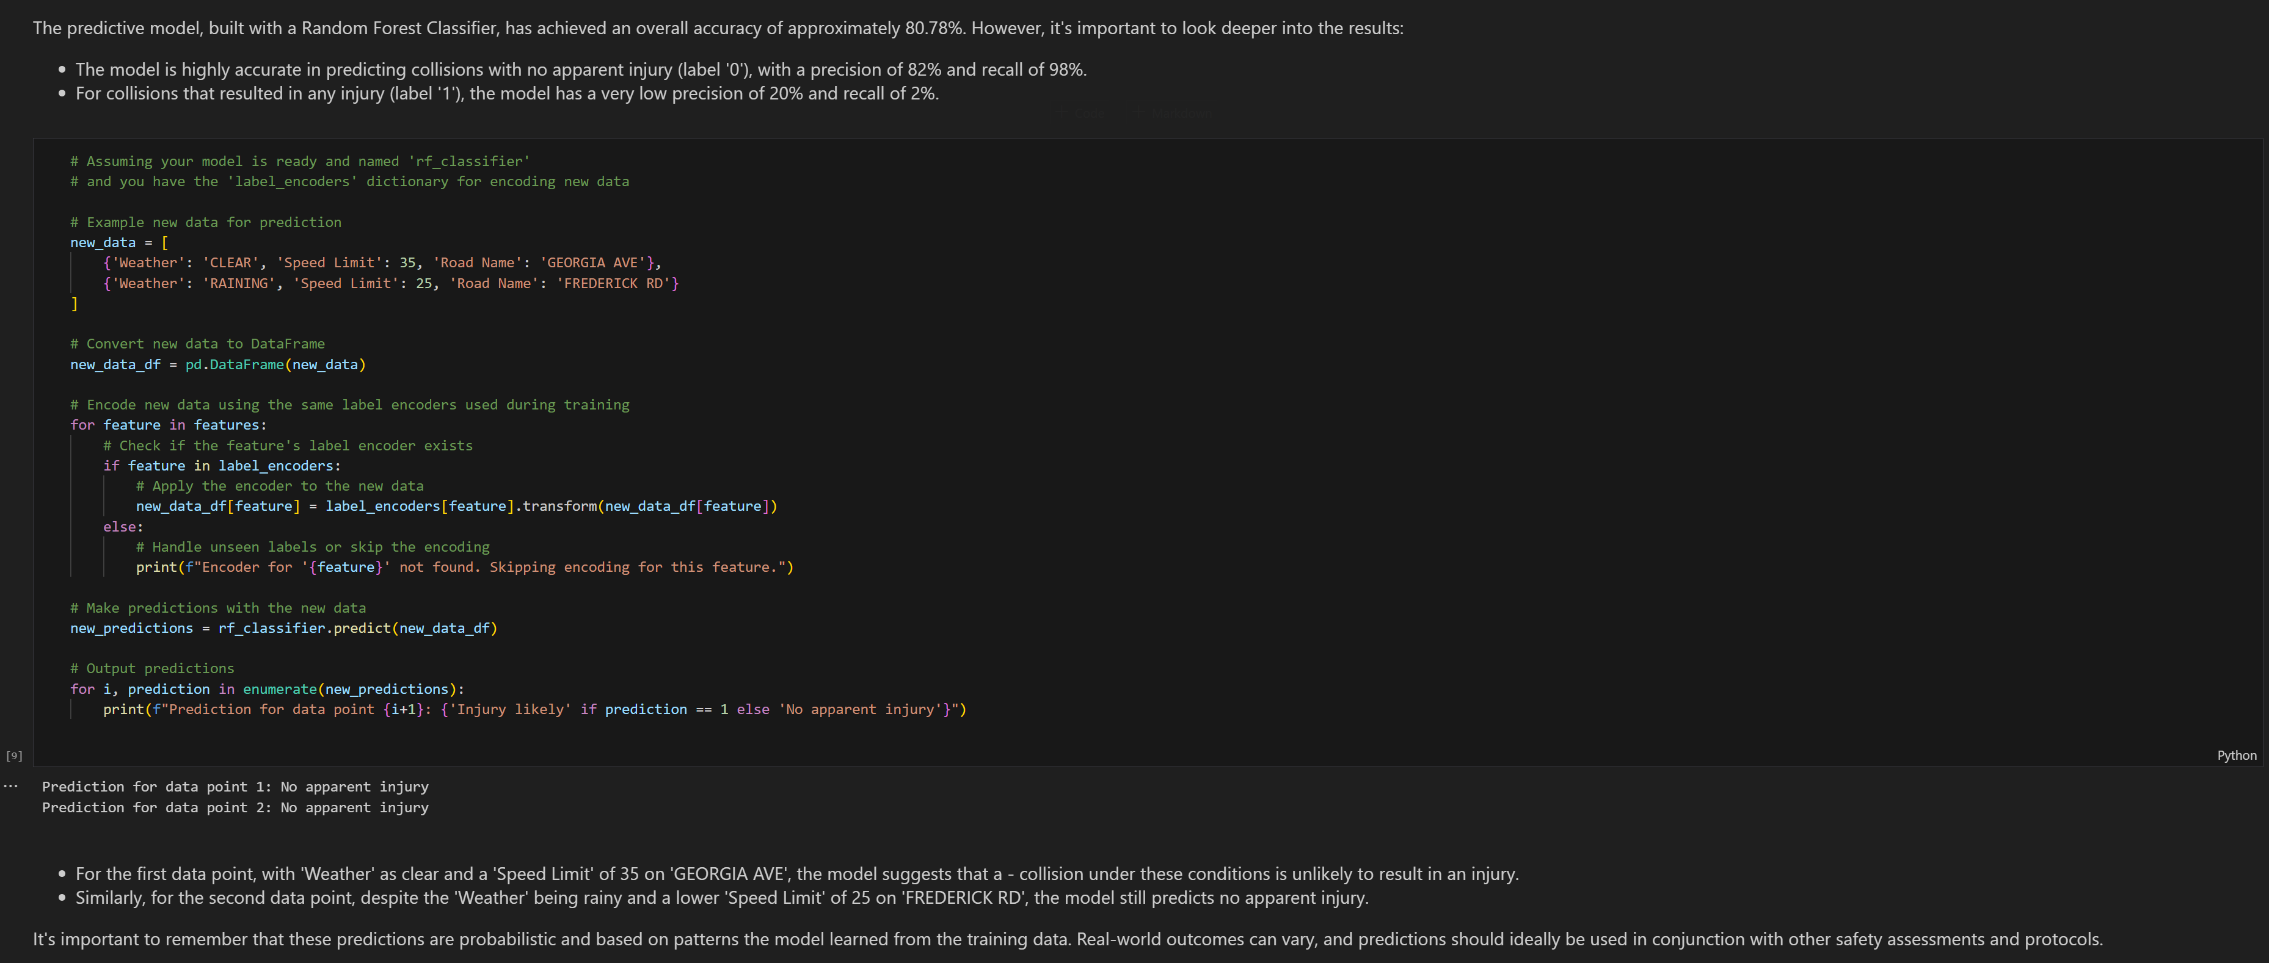
Predictive model – python code
Notes:
Use the SQL Server Management Studio (SSMS) tool to produce the SQL Query.
In this slide provide the SQL Query in text format, not screen shot format.

Slide 35
Evaluation

Slide 36
Conclusion – Answers to Questions
The collision data indicates a trend of stable to slightly increasing annual collision counts over the years, with a forecasted rise in the future. Seasonally, there is a notable peak in collisions during the later months of the year, particularly from September to November, which may suggest an increase in risk factors during these months, such as weather changes, increased holiday traffic, or low visibility. This pattern underlines the importance of targeted safety measures during the fall season, possibly adjusting for factors like road conditions and driver behavior. It also prompts a review of current safety measures to assess their effectiveness and adapt accordingly, ensuring continuous improvement in traffic management and collision prevention.
Montgomery County should prioritize safety enhancements on Georgia Avenue and other high-collision roads, enforcing strict speed limit adherence and reevaluating road safety designs. The data suggests that collisions are not confined to high-speed areas, indicating the need for broader safety measures beyond speed management. Weather-related collisions, while less frequent, still signify the need for dynamic traffic systems that adjust advisories and speed limits based on real-time weather conditions. Increasing driver awareness during clear weather, when most collisions occur, could also significantly improve road safety.
Notes:
The answer to the question from Slide 15 needs to be supported by the data visualized in the previous steps.

Slide 37
Conclusion – Answers to Questions
Analyzing the heatmap of traffic collisions by severity across the region, it’s evident that resources for emergency response and traffic safety enhancements should be focused on the dense clusters of severe injuries located centrally around urban centers. The high frequency of fatal and serious injuries in these areas calls for a strategic allocation of resources, such as more emergency response units and advanced traffic safety infrastructure, to potentially reduce response times and prevent future incidents. Furthermore, given the patterns observed on specific roadways like Georgia Avenue and Rockville Pike, targeted interventions such as enhanced road signage, public awareness campaigns, and speed enforcement could be effective.
Data-driven road safety policies should heavily emphasize the reduction of collisions related to driver substance abuse and distraction. The data indicates alcohol presence contributes to a significant number of collisions; hence, policies could include stringent DUI laws, regular sobriety checkpoints, and educational programs about the dangers of driving under the influence. Driver distraction, particularly from inattentiveness, accounts for a substantial portion of collisions. This suggests a need for awareness campaigns targeting driver focus and legislation that penalizes distracted driving. Implementing technology in vehicles that restricts mobile phone usage or provides active reminders to maintain attention could also be effective strategies to mitigate these risks.
Notes:
The answer to the question from Slide 15 needs to be supported by the data visualized in the previous steps.

Slide 38
Conclusion – Answers to Questions
The analysis of collision frequencies suggests that passenger cars, followed by sport utility vehicles (SUVs), are involved in the majority of traffic accidents. This highlights the need for targeted vehicle safety standards specifically designed for these types of vehicles. Additionally, the fact that the vast majority of equipment-related collisions are not due to misuse indicates that there could be a need for improvements in vehicle safety features and their reliability. Given that most collisions occur while the vehicle is in motion rather than stationary, proactive safety features like advanced driver assistance systems (ADAS) could be instrumental in preventing accidents. Furthermore, as specific makes like Toyota and Honda are more frequently involved in collisions, manufacturers should be encouraged to implement additional safety measures and perhaps initiate targeted awareness campaigns for the owners of these vehicles.
Notes:
The answer to the question from Slide 15 needs to be supported by the data visualized in the previous steps.

Slide 39
Final Conclusion
Our data-driven analysis has illuminated key areas for improving road safety in Montgomery County:
Vehicle Safety: Focus on passenger cars and SUVs with advanced safety systems, as they're most involved in collisions.
Impaired & Distracted Driving: Intensify efforts against DUI and distraction through stricter laws and educational campaigns.
Strategic Resource Allocation: Utilize data on high-incident areas like Georgia Avenue for targeted safety improvements.
Weather-Adaptive Strategies: Implement adaptive traffic systems for clear weather, where a surprising number of collisions occur.
Predictive Insights: Employ predictive analysis, like random forest models, for preemptive safety measures.
By synthesizing insights from our comprehensive analysis and predictive modeling, we propose a strategic framework to significantly reduce traffic incidents and enhance safety for Montgomery County residents.
Notes:
The answer to the question from Slide 15 needs to be supported by the data visualized in the previous steps.

Slide 40
Thank You

